Slide 1
Neural Networks as Universal Value Approximators
One of the most striking facts about neural networks is that they can compute any function out there!
Neural networks have a kind of universality. No matter what function we want to compute, we know that there is a neural network which can do the job. That is why they are known as Universal Value Approximators.
If you’re interested to learn more about it, this article gives a simple and mostly visual explanation of the universality theorem:
http://neuralnetworksanddeeplearning.com/chap4.html

Slide 2
Till now you’ve worked with MLP and CNN and that introduced you to the world of Deep Learning.
But what’s more out there? Let’s have a look

Slide 3

Recurrent Neural Network (RNN)
Imagine that you are watching a movie. Most likely you would be able to connect to the scenes of the movie and understand what is happening, right? All our thinking goes in a flow and based on previous frame we can connect the current frame easily. Our thoughts have persistence.
Well, can we expect a neural network to make sense out of it? Not really!
Our traditional neural network architectures (Feed-forward neural networks) cannot do this. Given a particular sequence of frames, they cannot predict or understand what is happening at each point in the movie.
They have no memory of the input they receive and are bad at predicting what’s coming next. Because a feed-forward network only considers the current input, it has no understanding of sequence or time. It simply can’t remember anything about what happened in the past except its training.

Slide 4
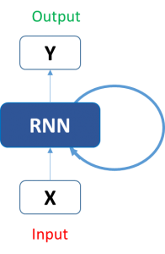
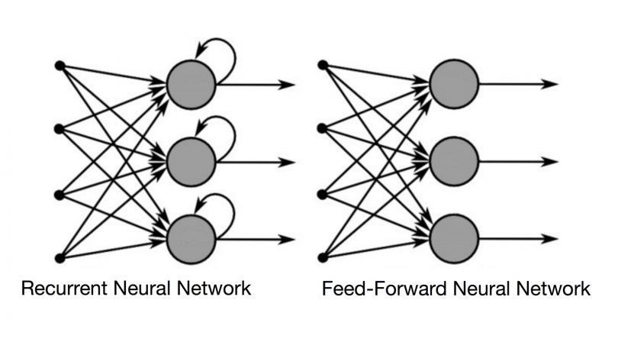
Recurrent Neural Network (RNN)
Here comes the RNN.
In a RNN the information cycles through a loop. When it makes a decision, it considers the current input and also what it has learned from the inputs it received previously.
Below is side by side comparison of a regular Feed Forward Neural Network (MLP) and a Recurrent Neural Network (RNN). We can see that RNN is following a loop and learning from current and previous inputs.

Slide 5
Recurrent Neural Network (RNN)
Recurrent neural networks (RNNs) are a class of neural network that are helpful in modeling sequence data. Derived from feedforward networks, RNNs exhibit similar behavior to how human brains function. Simply put: recurrent neural networks produce predictive results in sequential data that other algorithms can’t.
Feed-forward neural networks have no memory of the input they receive and are bad at predicting what’s coming next. Because a feed-forward network only considers the current input, it has no notion of order in time. It simply can’t remember anything about what happened in the past except its training.
In an RNN, the information cycles through a loop. When it makes a decision, it considers the current input and also what it has learned from the inputs it received previously.

Slide 6
Recurrent Neural Network (RNN)
Therefore, an RNN has two inputs: the present and the recent past. This is important because the sequence of data contains crucial information about what is coming next, which is why an RNN can do things other algorithms can’t.
A feed-forward neural network assigns, like all other deep learning algorithms, a weight matrix to its inputs and then produces the output. Note that RNNs apply weights to the current and also to the previous input.

Slide 7
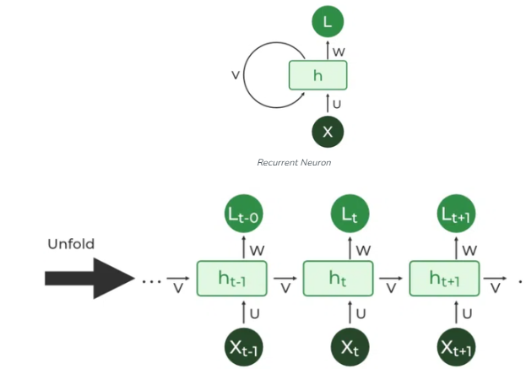
Recurrent Neural Network (RNN)

Slide 8
Types of Recurrent Neural Network (RNN)
One to One:
This type of RNN behaves the same as any simple Neural network it is also known as Vanilla Neural Network. In this Neural network, there is only one input and one output.
One To Many
In this type of RNN, there is one input and many outputs associated with it. One of the most used examples of this network is Image captioning where given an image we predict a sentence having Multiple words.

Slide 9
Types of Recurrent Neural Network (RNN)
Many to One
In this type of network, Many inputs are fed to the network at several states of the network generating only one output. This type of network is used in problems like sentimental analysis. Where we give multiple words as input and predict only the sentiment of the sentence as output.
Many to Many
In this type of neural network, there are multiple inputs and multiple outputs corresponding to a problem. One Example of this Problem will be language translation. In language translation, we provide multiple words from one language as input and predict multiple words from the second language as output

Slide 10
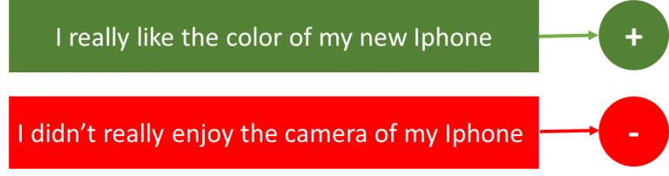
Applications of RNN
Sentiment Classification: This can be a task of simply classifying tweets into positive and negative sentiment. So here the input would be a tweet of varying lengths, while output is of a fixed type and size.

Slide 11
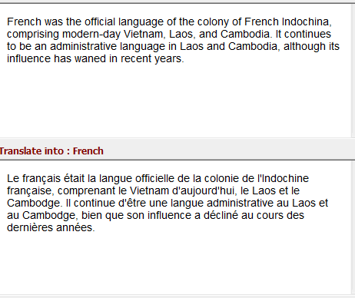
Applications of RNN
Language Translation: Imagine, we want to translate text from one language (English) to other language (French). Each language has its own semantics and would have varying lengths for the same sentence. So here the inputs as well as outputs are of varying lengths.

Slide 12
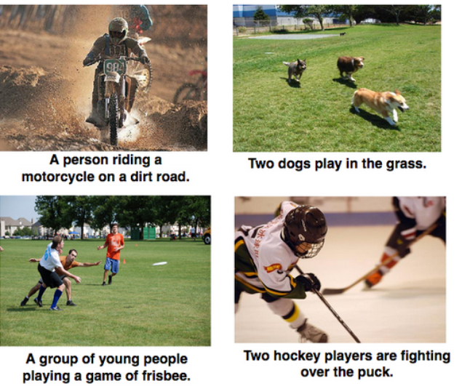
Applications of RNN
Image Captioning – Here, let’s say we have an image for which we need a textual description. So we have a single input – the image, and a series or sequence of words as output. Here the image might be of a fixed size, but the output is a description of varying lengths

Slide 13
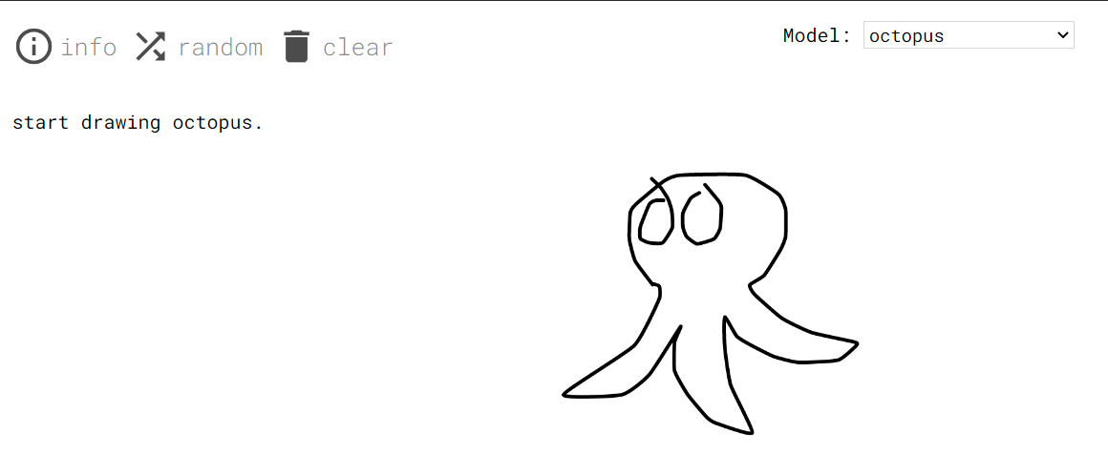
Applications of RNN - SketchRNN
https://magenta.tensorflow.org/assets/sketch_rnn_demo/index.html
This application learns to complete drawings. It’s pretty fun to play around with. Try it out!
You don’t need to do much here, just put a dot or add a line and the application would do the rest!

Slide 14
Issues with Standard RNNs
Gradient vanishing problems
Exploding gradient problems
Training an RNN is a comparatively difficult task.
It cannot process very long sequences if using tanh or relu as an activation function.

Slide 15
Long Short-Term Memory (LSTM)
Long Short-Term Memory (LSTM) networks are a modified version of recurrent neural networks(RNNs), which makes it easier to remember past data in memory.
A traditional RNN has a single hidden state that is passed through time, which can make it difficult for the network to learn long-term dependencies. LSTMs address this problem by introducing a memory cell, which is a container that can hold information for an extended period.
The vanishing gradient problem of RNN is resolved here.

Slide 16
Long Short-Term Memory (LSTM)
The memory cell is controlled by three gates: the input gate, the forget gate, and the output gate. These gates decide what information to add to, remove from, and output from the memory cell. The input gate controls what information is added to the memory cell. The forget gate controls what information is removed from the memory cell. And the output gate controls what information is output from the memory cell. This allows LSTM networks to selectively retain or discard information as it flows through the network, which allows them to learn long-term dependencies.

Slide 17
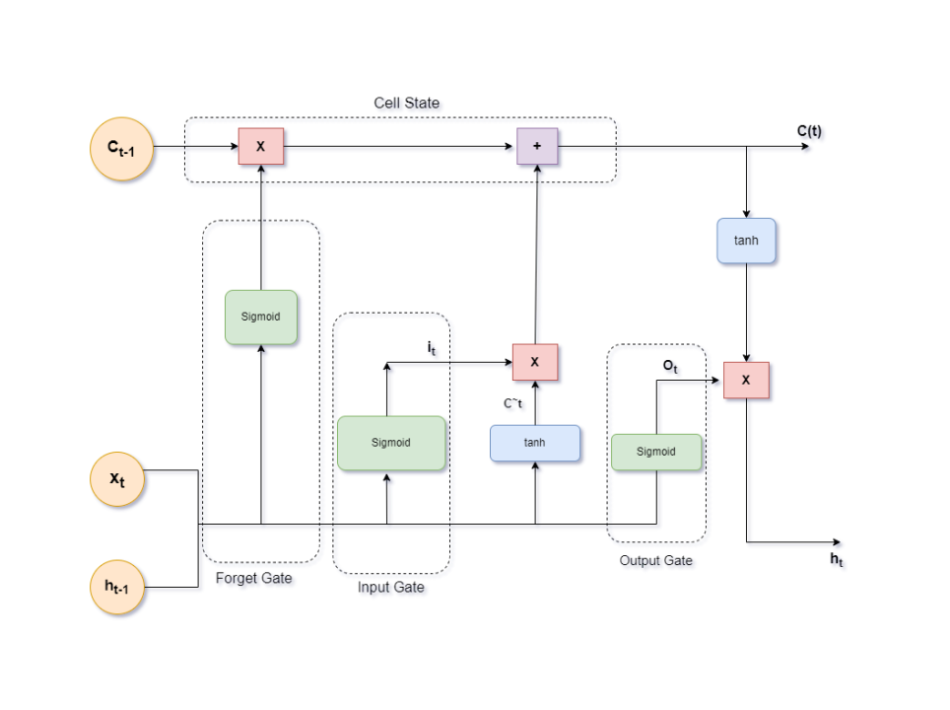
Architecture of LSTM

Slide 18
Long Short-Term Memory (LSTM)
Step 1: The LSTM receives the input vector (xt) and the previous state (ht-1, ct-1).
Step 2: The forget gate (ft) decides what information to discard from the cell state. It uses the input vector and the previous hidden state to generate a number between 0 and 1 for each number in the cell state ct-1. A 1 represents "completely keep this" while a 0 represents "completely get rid of this".
Step 3: The input gate (it) decides what new information to store in the cell state. It has two parts. A sigmoid layer called the "input gate layer" decides which values we'll update, and a tanh layer creates a vector of new candidate values (Ct~) that could be added to the state.

Slide 19
Long Short-Term Memory (LSTM)
Step 4: Update the old cell state (ct-1) to the new cell state (ct). The old cell state is multiplied by ft to forget the things we decided to forget earlier. Then we add the new candidate values, scaled by how much we decided to update each state value.
Step 5: Decide the output. This output will be based on our cell state, but will be a filtered version. First, we run a sigmoid layer which decides what parts of the cell state we're going to output. Then, we put the cell state through tanh (to push the values to be between -1 and 1) and multiply it by the output of the sigmoid gate, so we only output the parts we decided to.

Slide 20
Gated Recurrent Unit (GRU)
GRU (Gated Recurrent Unit) aims to solve the vanishing gradient problem which comes with a standard recurrent neural network.
GRU can also be considered as a variation on the LSTM because both are designed similarly and, in some cases, produce equally excellent results.
Notes:
The vanishing gradient problem in RNNs occurs because, as the gradients are propagated backwards through time, they can become very small due to the repeated multiplication of gradients in each time step.

Slide 21
Bidirectional LSTM
Bi LSTMs are made up of two LSTM networks, one that processes the input sequence in the forward direction and one that processes the input sequence in the backward direction. The outputs of the two LSTM networks are then combined to produce the final output.
Bi LSTM have been shown to achieve state-of-the-art results on a wide variety of tasks, including machine translation, speech recognition, and text summarization.

Slide 22
Transformer
Sequence-to-Sequence (or Seq2Seq) is a neural net that transforms a given sequence of elements, such as the sequence of words in a sentence, into another sequence
Seq2Seq models are particularly good at translation, where the sequence of words from one language is transformed into a sequence of different words in another language. A popular choice for this type of model is Long-Short-Term-Memory (LSTM)-based models. With sequence-dependent data, the LSTM modules can give meaning to the sequence while remembering (or forgetting) the parts it finds important (or unimportant). Sentences, for example, are sequence-dependent since the order of the words is crucial for understanding the sentence. LSTM are a natural choice for this type of data.

Slide 23
Transformer
Seq2Seq models consist of an Encoder and a Decoder. The Encoder takes the input sequence and maps it into a higher dimensional space (n-dimensional vector). That abstract vector is fed into the Decoder which turns it into an output sequence. The output sequence can be in another language, symbols, a copy of the input, etc.

Slide 24
Example
Imagine the Encoder and Decoder as human translators who can speak only two languages. Their first language is their mother tongue, which differs between both of them (e.g. German and French) and their second language an imaginary one they have in common. To translate German into French, the Encoder converts the German sentence into the other language it knows, namely the imaginary language. Since the Decoder is able to read that imaginary language, it can now translates from that language into French. Together, the model (consisting of Encoder and Decoder) can translate German into French!

Slide 25
Example
Suppose that, initially, neither the Encoder or the Decoder is very fluent in the imaginary language. To learn it, we train them (the model) on a lot of examples.
A very basic choice for the Encoder and the Decoder of the Seq2Seq model is a single LSTM for each of them.
You’re wondering when the Transformer will finally come into play, aren’t you?
Attention. The attention mechanism looks at an input sequence and decides at each step which other parts of the sequence are important. It sounds abstract, but let me clarify with an easy example: When reading this text, you always focus on the word you read but at the same time your mind still holds the important keywords of the text in memory in order to provide context.

Slide 26
Example
An attention-mechanism works similarly for a given sequence. For our example with the human Encoder and Decoder, imagine that instead of only writing down the translation of the sentence in the imaginary language, the Encoder also writes down keywords that are important to the semantics of the sentence, and gives them to the Decoder in addition to the regular translation. Those new keywords make the translation much easier for the Decoder because it knows what parts of the sentence are important and which key terms give the sentence context.

Slide 27
Example
In other words, for each input that the LSTM (Encoder) reads, the attention-mechanism takes into account several other inputs at the same time and decides which ones are important by attributing different weights to those inputs. The Decoder will then take as input the encoded sentence and the weights provided by the attention-mechanism

Slide 28
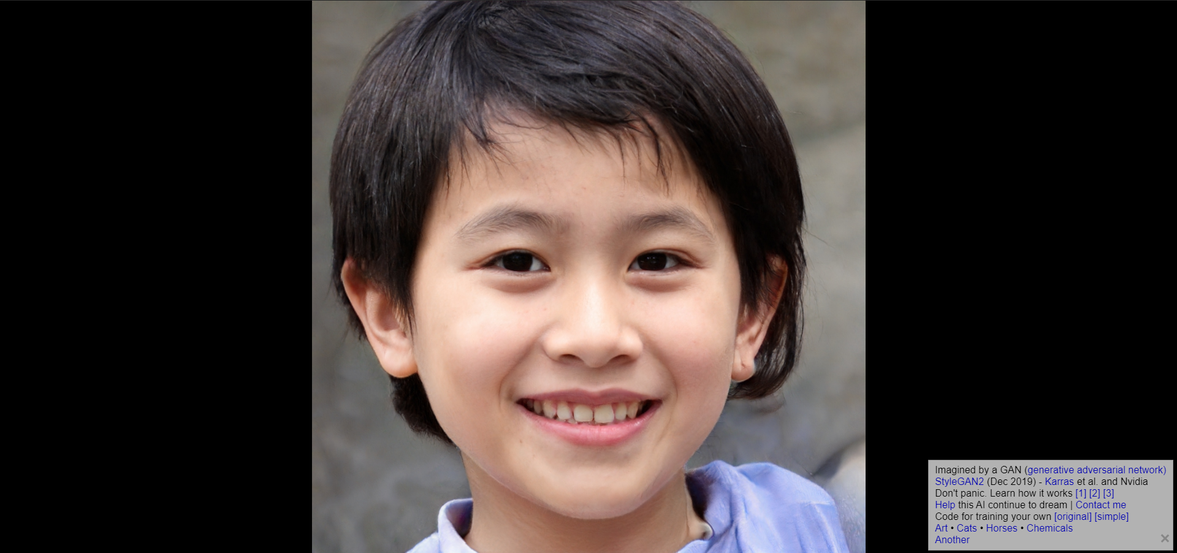
Generative Adversarial Network (GAN)
Go to https://thispersondoesnotexist.com/
What do you see? A normal human being, right?
If you didn't figure out from the website name yet, the person you saw does not actually exist! It's an image generated by a Deep Learning technique called GAN. Each time you refresh the website, you'll see a completely new person.
How cool is that?

Slide 29
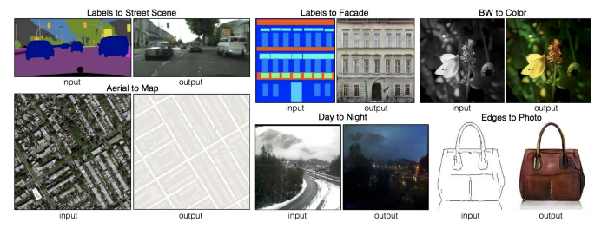
Generative Adversarial Network (GAN)
Let us look at some examples to understand what a GAN and its variants are capable of:
Given an image of the road, the network is able to fill in the details with objects such as cars etc.
The network is able to convert a black & white image into colour.
Given an aerial map, the network is able to find the roads in the image.
It is also able to fill in the details of a photo, given the edges.

Slide 30
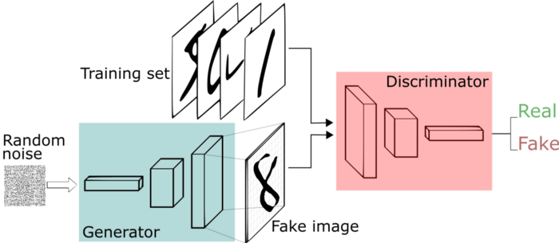
Generative Adversarial Network (GAN)
The network learns to generate from a training distribution through a 2-player game. The two entities are Generator and Discriminator.
As you can identify from their names, a generator is used to generate real-looking images and the discriminator’s job is to identify which one is a fake. No need to get into their details at the moment. Just enjoy the glory of GANs!

Slide 31
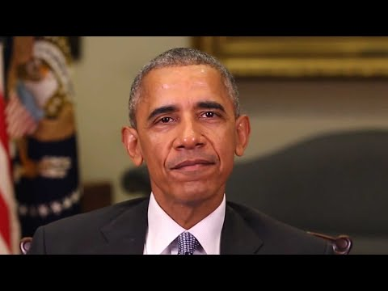
DeepFakes
Creating convincing image, audio and video hoaxes.

Slide 32
DeepFakes
Yes, the things in the previous video were definitely not said by former US President Barack Obama.
Once upon a time, the researchers were keen on creating DeepFakes.
Now, they are working on detecting them!

Slide 33
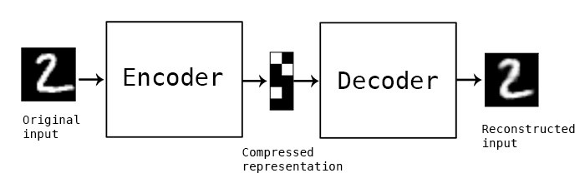
Autoencoders
Autoencoder learns how to efficiently compress and encode data then learns how to reconstruct the data back.
It reduces data dimensions by learning how to ignore the noise in the data.

Slide 34
Applications of Autoencoders
Dimensionality Reduction
Image Compression
Image Denoising
Feature Extraction
Image generation
Sequence to sequence prediction
Recommendation system

Slide 35
Additional Material (Optional)
A very basic introduction to implementing a Recurrent Neural Network: https://pythonprogramming.net/recurrent-neural-network-deep-learning-python-tensorflow-keras/
Implementing GANs in Tensorflow 2.0:
https://towardsdatascience.com/demystifying-gans-in-tensorflow-2-0-9890834ab3d9
Autoencoder with Tensorflow 2.0:
https://www.geeksforgeeks.org/ml-autoencoder-with-tensorflow-2-0/

Slide 36
That’s just the tip of the iceberg. There are SO MANY more neural networks out there!
Just to name a few more:
Boltzmann Machine
Bidirectional LSTMs
Deep Belief Networks
Radial Basis Function Neural Networks

